Slide 1
Community Connect using CI/CD Pipeline
Bringing Your Community Closer Together
Team Members:
Mrunal Patil
Divyank Agarwal
Sreekanth Sanam
Aditi Sonawane
INDIANA UNIVERSITY BLOOMINGTON

Slide 2
Introduction and Motivation
SECTION 1

Slide 3
Introduction and Motivation
Community Connect App
The Community Connect App is a cloud-based platform that utilizes AWS services to facilitate seamless communication and engagement between neighbors. The app provides a centralized hub for neighbors to come together and share information about local events, services, and anything else that they believe would be beneficial to their community.With the ability to set post priority and trigger email notifications for high-priority posts, residents stay informed. Our AWS pipeline automates the deployment of new code releases from Github, ensuring a smooth and hassle-free user experience.

Slide 4
Community Connect Using AWS
SECTION 2

Slide 5
Motivation For Using AWS
Community Connect App
Easy integration: AWS offers a wide range of services that can be easily integrated with each other, allowing developers to create a fully-functional application without having to manage multiple third-party services. This can simplify the development process and make it easier to maintain the application over time.
Elasticity: AWS offers elastic infrastructure services that allow businesses to easily scale up or down their resources depending on demand. This means that as the user base grows, the platform can easily handle increased traffic and usage without requiring significant infrastructure changes.
Cost-effectiveness: AWS offers a pay-as-you-go pricing model, allowing businesses to only pay for the resources they use. This can be more cost-effective than maintaining physical infrastructure and can help businesses to manage their costs more effectively.
Security: AWS invests heavily in security measures to protect their customers' data. By using AWS services, businesses can take advantage of these security measures without having to invest in their own security infrastructure.
Wide range of services: AWS offers a wide range of services, from compute and storage to machine learning and artificial intelligence. This means that businesses can easily incorporate advanced technologies into their applications without having to manage multiple third-party services.

Slide 6
Related Work
SECTION 3

Slide 7
Community Connect App
Previous Work
Continuous Integration and Continuous Delivery (CI/CD) is increasingly important in modern software development.
"Continuous Integration, Delivery and Deployment: A Systematic Review on Approaches, Tools, Challenges and Practices" provides valuable insights into the current state of CI/CD practices.
Best practices such as a robust testing strategy, using version control, and promoting a DevOps culture can help overcome the challenges associated with CI/CD implementation.
"Practising Continuous Integration and Continuous Delivery on AWS" discusses how to apply DevOps techniques on the Amazon Web Services (AWS) infrastructure to speed up software delivery.
Amazon tools including AWS CodePipeline, AWS CodeBuild, and AWS CodeDeploy are used to construct a CI/CD pipeline.

Slide 8
Our Architecture
SECTION 4

Slide 9
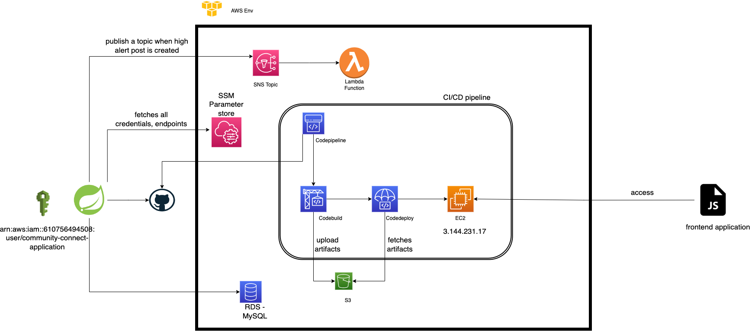
Community Connect App

Slide 10
Challenges Faced
SECTION 5

Slide 11
Challenges:
Hard to integrate enterprise github(github.iu.edu)
It was difficult to fetch environment variables from EC2 instance.
New to AWS Developer tools.
Community Connect App

Slide 12
Future Work
SECTION 6

Slide 13
FutureWork
Community Connect App
Developers POV:
Develop separate pipeline when each PR is raised and perform codebuild functionality to manage everything is tested and built.
Improve logging to get alerts on slack whenever any error is occurred.
Develop separate environment wise pipelines. Eg. integration, prelive, production
Use of IaaC to manage AWS resources.
Application / Users POV:
Develop mobile application to receive instant notifications instead of email.

Slide 14
Demo
SECTION 7

Slide 15
Thank You!

